Slide 1
Software Engineering
COMP 201
Lecturer: Sebastian Coope
Ashton Building, Room G.18
E-mail: coopes@liverpool.ac.uk
COMP 201 web-page:
http://www.csc.liv.ac.uk/~coopes/comp201
Lecture 4 – Software Requirements

Slide 2
Software Requirements
Descriptions and specifications of a system
Objectives:
To introduce the concepts of user and system requirements
To describe functional / non-functional requirements
To explain two techniques for describing system requirements

Slide 3
Requirements Engineering
Requirements engineering is the process of establishing
the services that the customer requires from a system
the constraints under which it operates and is developed
Requirements
The descriptions of the system services and constraints
that are generated during the requirements engineering process

Slide 4
Why do we need Requirements?
To ensure a software solution correctly solves a particular problem, we must
  fully understand the problem that needs to be solved
  discover why the problem needs to be solved
  determine who should be involved.
Poorly defined requirements can cause major problems to a project in both financial terms as well as added time.

Slide 5
What is a Requirement?
It may range from a high-level abstract statement of a service or of a system constraint to a detailed mathematical functional specification
This is inevitable as requirements may serve a dual function
  May be the basis for a bid for a contract - therefore must be open to interpretation
  May be the basis for the contract itself - therefore must be defined in detail
  Both of these statements may be called requirements

Slide 6
Examples (requirements iteration)
The system will support a wide range of the most commonly used graphics file formats
The system may support the following file formats: png, jpeg, tiff and gif
The system may support the following file formats: png, jpeg, tiff and gif, to a maximum resolution of 1024x1024 pixels
The system may support the following file formats: png, jpeg, tiff and gif, to a maximum resolution of 1024x1024 pixels and a maximum file size of 20 megabytes with these parameters being extendable easily using plug ins

Slide 7
Types of Requirement
User requirements
  Statements in natural language plus diagrams of the services the system provides and its operational constraints. Written for customers
System requirements
  A structured document setting out detailed descriptions of the system services. Written as a contract between client and contractor
Software specification
  A detailed software description which can serve as a basis for a design or implementation. Written for developers

Slide 8
Examples
User requirement
  We need to be able to spell check documents
System requirement
  The system needs to be able to spell check documents and provide autocorrect facilities. Their will be support for the following languages, English, French and German will have plug in support for other languages
Software specification
  CheckResult spellCheck(String word, Dictionary dictionary)
    Word is defined in UNICODE formatted string
    The Dictionary structure is defined in S.1.2
    The CheckResult is defined in S.1.3 and contains a flag if the word has been found or not, plus a Vector object containing a list of possible other word suggestions depending if the word has been found or not
    spellCheck will ideally use Hashing tables to improve code efficiency
    ……

Slide 9
Functional and Non-Functional Requirements
Functional requirements
  Statements of services the system should provide, how the system should react to particular inputs and how the system should behave in particular situations
Non-functional requirements
  constraints on the services or functions offered by the system such as timing constraints, constraints on the development process, standards, etc. Usually defined on the system as a whole
Domain requirements
  Requirements that come from the application domain of the system and that reflect characteristics of that domain

Slide 10
Examples of Functional Requirements
All users will access the system using a user id and a password
The system shall support the following document formats: PDF, RTF, Microsoft Word 2010 and ASCII text
Every order shall be allocated a unique identifier (ORDER_ID)
The system have a mechanism to help recover a user’s password

Slide 11
Requirements Imprecision
Problems arise when requirements are not precisely stated
Ambiguous requirements may be interpreted in different ways by developers and users
Consider the term ‘recover password’ from previous slide..
  User intention – mechanism which allows the user to view the password after going through an authentication procedure
  Developer interpretation – allowing the user to reset their password so that it can be set again (e.g. using email link)
Before development is to commence requirements should be defined as precisely as possible

Slide 12
Requirements Completeness and Consistency
In principle requirements should be both complete and consistent:
Complete
  They should include descriptions of all facilities required
Consistent
  There should be no conflicts or contradictions in the descriptions of the system facilities
In practice, it is very difficult or impossible to produce a complete and consistent requirements document

Slide 13
Non-Functional Requirements
Define system properties and constraints e.g. reliability, response time and storage requirements. Constraints are I/O device capability, system representations, etc. They are often emergent properties of the system.
Process requirements may also be specified, mandating a particular CASE system, programming language or development method
Non-functional requirements may be more critical than functional requirements. If these are not met, the system is useless (e.g. key length for encrypting secure email must be >=256 bits)

Slide 14
Non-Functional Classifications
Product requirements
  Requirements which specify that the delivered product must behave in a particular way e.g. execution speed, reliability, security etc.
Organisational requirements
  Requirements which are a consequence of organisational policies and procedures e.g. process standards used, implementation requirements, etc. (Java as programming language)
External requirements
  Requirements which arise from factors which are external to the system and its development process e.g. interoperability requirements, legislative requirements, etc. (Must conform to FIPS

Slide 15
Non-Functional Requirements Examples
Product requirement
  All encryption should use the Advanced Encryption Standard
Organisational requirement
  The system development process and deliverable documents shall conform to the process and deliverables defined in coding and documentation standard XYZCo-SP-STAN-95
External requirement
  The system shall not disclose any personal information about customers apart from their name and reference number to the operators of the system
Performance requirement
  The system should respond to a user’s request for information in less than 0.1 seconds during “peak-time” and 0.01 seconds during “normal time”.

Slide 16
Goals and Requirements
Non-functional requirements may be very difficult to state precisely and imprecise requirements may be difficult to verify.
Verifiable non-functional requirement
  A statement using some measure that can be objectively tested
Goal
  A general intention of the user such as ease of use
Goals are helpful to developers as they convey the intentions of the system users

Slide 17
Examples
An example system goal
  The system should be easy to use by experienced controllers and should be organised in such a way that user errors are minimised.
An example verifiable non-functional requirement
  Experienced controllers shall be able to use all the system functions after a total of two hours training. After this training, the average number of errors made by experienced users shall not exceed two per day.

Slide 18
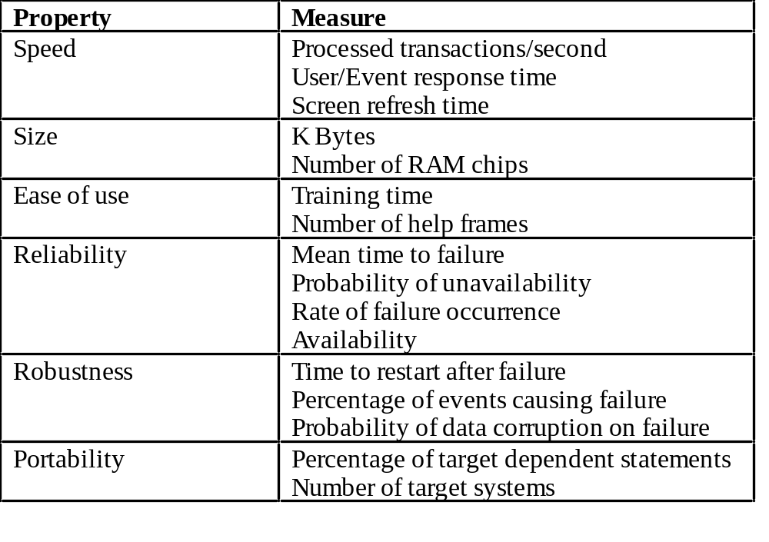
Requirements Measures

Slide 19
Requirements Interaction
Conflicts between different non-functional requirements are common in complex systems
Username/Password mechanism should be easy for user to use
All passwords must be hard to guess and ideally require upper/lower case letters and special symbols to ensure high security
  Which is the most critical requirement?

Slide 20
Example Domain Requirement
Healthcare information system:
  All information systems should be compliant with The data protection act, Health and Social Care Act 2012, NHS Act 2006,
  Example :
  People within the healthcare system using data for secondary purposes must only use data that do not identify individual patients unless they have the consent of the patient themselves.

Slide 21
Domain Requirements Problems
Understandability
  Requirements are expressed in the language of the application domain
  This is often not understood by software engineers developing the system (e.g. consider the previous slide) would they understand the law associated with data processing
Implicitness
  Domain specialists understand the area so well that they do not think of making the domain requirements explicit which leads to problems later if software developer implements the requirements in the wrong way

Slide 22
User Requirements
User requirements should describe functional and non-functional requirements so that they are understandable by system users who don’t have detailed technical knowledge
User requirements are defined using natural language, tables and diagrams in order that non-technical clients can better understand the requirements and point out potential problems.

Slide 23
Problems with Natural Language
Lack of clarity
  Precision is difficult without making the document difficult to read
Requirements confusion
  Functional and non-functional requirements tend to be mixed-up in same document
Requirements amalgamation
  Several different requirements may be expressed together
  Leads to problems with testing/debugging

Slide 24
Guidelines for Writing Requirements
Invent a standard format and use it for all requirements
Use language in a consistent way. Use
shall for mandatory requirements (that must be supported),
should for desirable requirements (that are not essential).
See RFC 2119
Use text highlighting to identify key parts of the requirement
Avoid the use of computer jargon
Try and make documents self contained (e.g. include glossaries and complete examples)

Slide 25
Lecture Key Points
Requirements set out what the system should do and define constraints on its operation and implementation
Functional requirements set out services the system should provide
Non-functional requirements constrain the system being developed or the development process
User requirements are high-level statements of what the system should do

